Slide 1
Linked Lists
Slides adapted from John Gilligan’s lecture on link lists

Slide 2
Array versus Linked Lists
Linked lists are more complex to code and manage than arrays, but they have some distinct advantages.
Dynamic: a linked list can easily grow and shrink in size.
We don’t need to know how many nodes will be in the list. They are created in memory as needed.
In contrast, the size of a C++ array is fixed at compilation time.
Easy and fast insertions and deletions
To insert or delete an element in an array, we need to copy to temporary variables to make room for new elements or close the gap caused by deleted elements.
With a linked list, no need to move other nodes. Only need to reset some pointers.

Slide 3
List Overview
Linked lists
Abstract data type (ADT)
It is Dynamic and so you can increase/decrease the size.
Unlike an array which is static: can not change the size at run time
Basic operations of linked lists
Insert, find, delete, print, etc.
Variations of linked lists
Stacks : e.g. the program/thread stack: (L.I.F.O.)
Queues: used for algorithms for scheduling processes to run on a CPU: (F.I.F.O.)

Slide 4
Linked Lists
A
B
C
∅
Head
A linked list is a series of connected nodes
Each node contains at least
A piece of data (any type; e.g. a structure – P.C.B.)
Pointer to the next node in the list
It has an address (&node)
Head: “pointer” to the first node
The last node points to NULL
node
A
data
pointer

Slide 5
A Simple Linked List structure
Linked lists are made up of Nodes
Declare Node structure for the nodes
data: char-type data in this example
next: a pointer to the next node in the list
// self-referential structure
struct listNode {
char data; // each listNode contains a character
struct listNode *nextPtr; // pointer to next node
};
typedef struct listNode ListNode; // synonym for struct listNode

Slide 6
Operations on Linked List
// prototypes
void insert(ListNode* *sPtr, char value);
char delete(ListNode* *sPtr, char value);
void printList(ListNode* currentPtr);
void menu(void);

Slide 7
Main function
int main(void)
{
ListNode* startPtr = NULL; // initially there are no nodes
char item; // char entered by user
instructions(); // display the menu
printf("%s", "? ");
unsigned int choice; // user's choice
scanf("%u", &choice);
// loop while user does not choose 3
while (choice != 3) {
switch (choice) {
case 1:
printf("%s", "Enter a character: ");
scanf("\n%c", &item);
insert(&startPtr, item); // insert item in list
printList(startPtr);
break;

Slide 8
Inserting a new node
Insert a node with data equal to x (in the example the note will be added in order) (i.e., when data = ‘c’ insert into linklist in alphabetical order.)
Steps
Locate node (current) before which new node is inserted
Allocate memory for the new node
Point the new node to the (current) node
Point the current node’s predecessor (previous) to the new node
index’th element
newNode

Slide 9
Inserting a new node
Possible cases of InsertNode
Insert into an empty list
Insert in front
Insert at back
Insert in middle
But, in fact, only need to handle two cases
Insert as the first node (Case 1 and Case 2)
Insert in the middle or at the end of the list (Case 3 and Case 4)

Slide 10
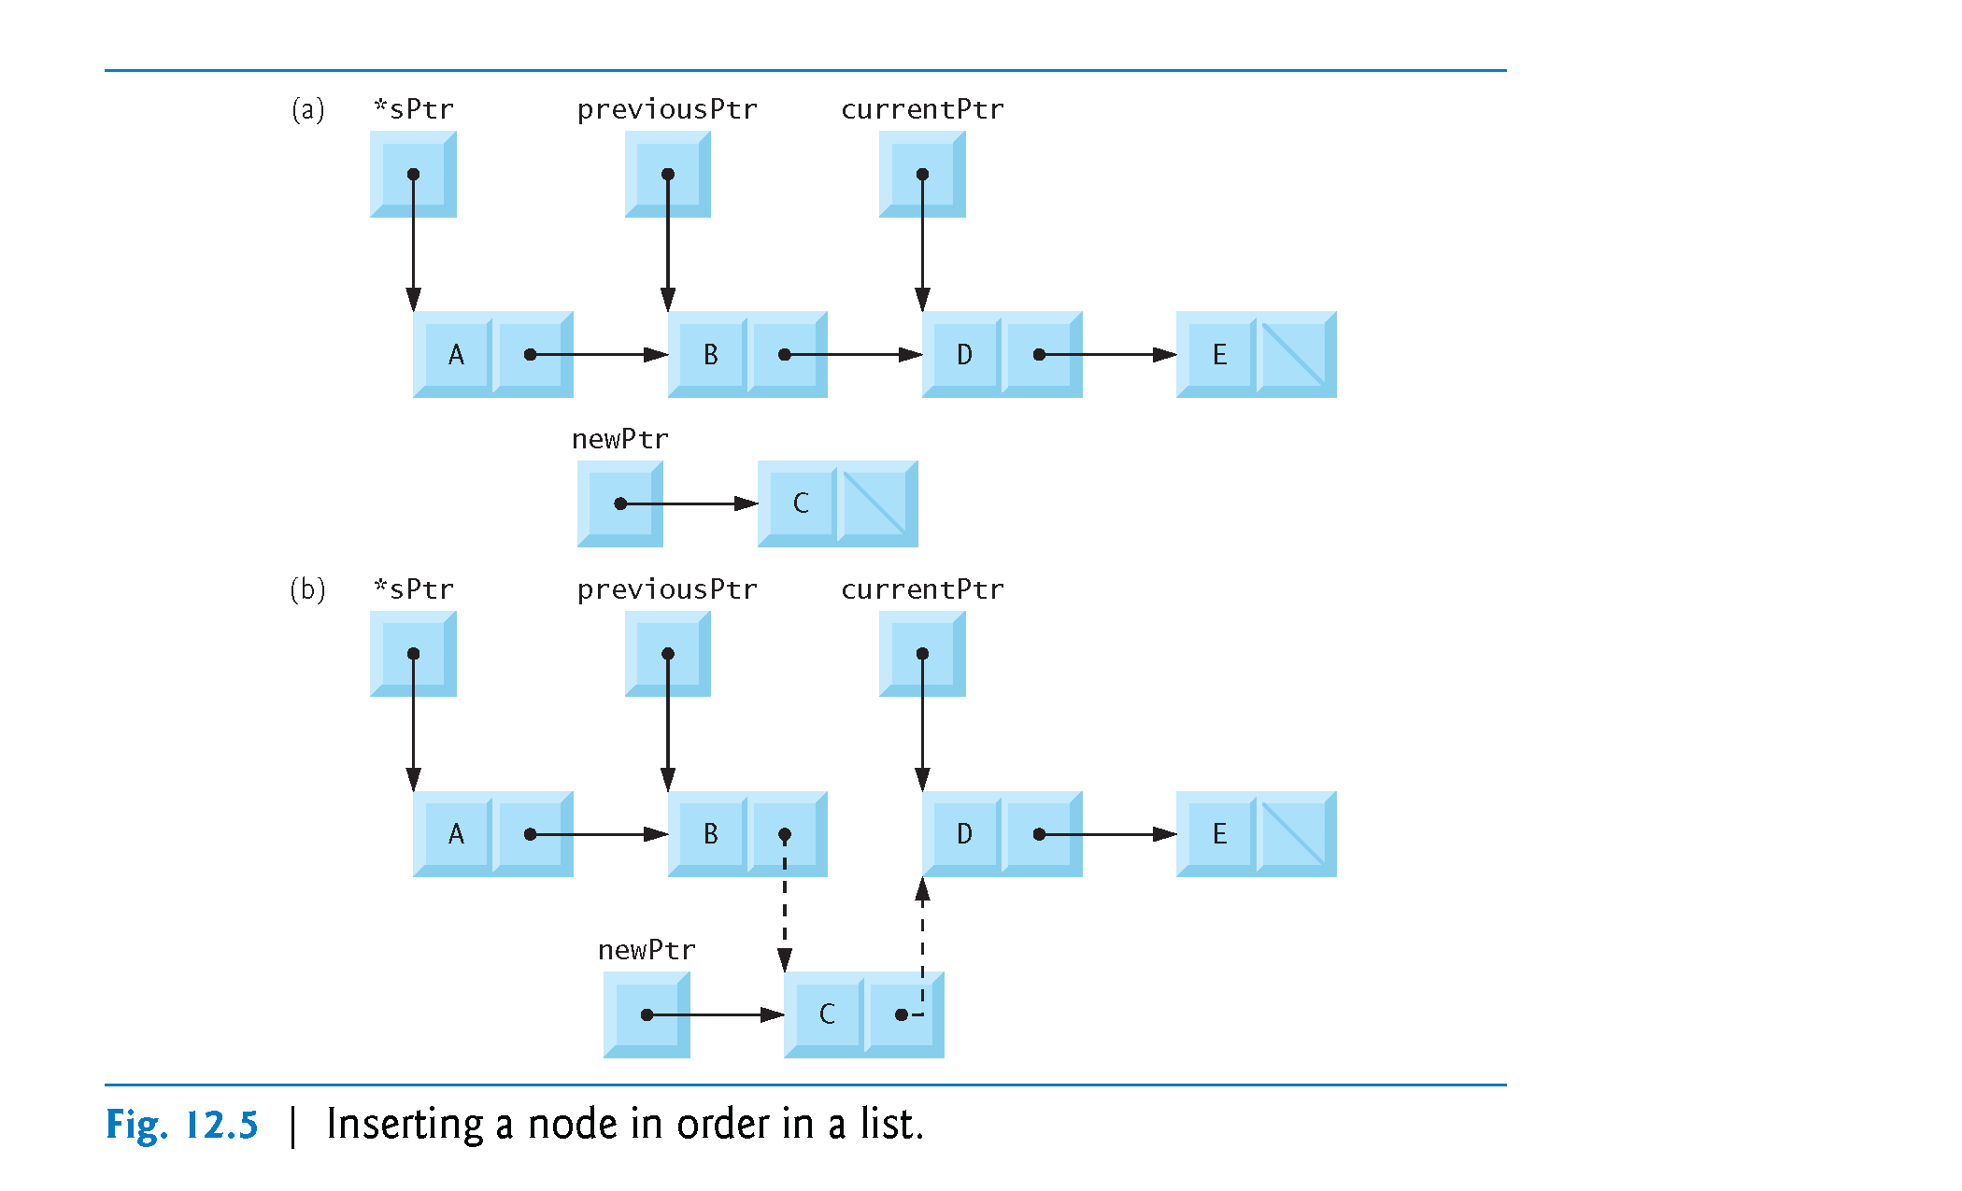

Slide 11
An example to illustrate
Assume size of node = 4
Assume address of head/startPtr node is 0x00
Assume address of sPtr is 0x02
Assume address of current is 0x04
Assume address of previous is 0x06
Address of the first new node is 0x12
Address of the another new node is 0x16…..
Assuming sPtr is a double pointer and points to startPtr. What is the value of *sPtr?
What would be the address and contents of the nodes and the pointers in the previous example ?

Slide 12
// insert a new value into the list in sorted order
void insert(ListNode* *sPtr, char value)
{
ListNode* newPtr = malloc(sizeof(ListNode)); // create node
if (newPtr != NULL) { // is space available
newPtr->data = value; // place value in node
newPtr->nextPtr = NULL; // node does not link to another node
ListNode* previousPtr = NULL; // assign default values to
ListNode* currentPtr = *sPtr; // current and prev pointers
// loop to find the correct location in the list
while (currentPtr != NULL && value > currentPtr->data) {
previousPtr = currentPtr; // walk to ...
currentPtr = currentPtr->nextPtr; // ... next node
}
// insert new node at beginning of list
if (previousPtr == NULL) {
newPtr->nextPtr = *sPtr;
*sPtr = newPtr;
}
else{
// insert new node between previousPtr and currentPtr
previousPtr->nextPtr = newPtr;
newPtr->nextPtr = currentPtr;
}
}
else {// Malloc returns NULL
printf("%c not inserted. No memory available.\n", value);
}
}

Slide 13
Deleting a node
char DeleteNode(ListNode * *sPtr, char x)
Delete a node with the value equal to x from the list.
If such a node is found, return its value. Otherwise, return ‘\0’ (Null character).
Steps
Find the desirable node (similar to insert fnt)
Release the memory occupied by the found node
Set the pointer of the predecessor (previous) of the found node (current) to the successor of the found node
Like InsertNode, there are two special cases
Delete first node
Delete the node in middle or at the end of the list

Slide 14
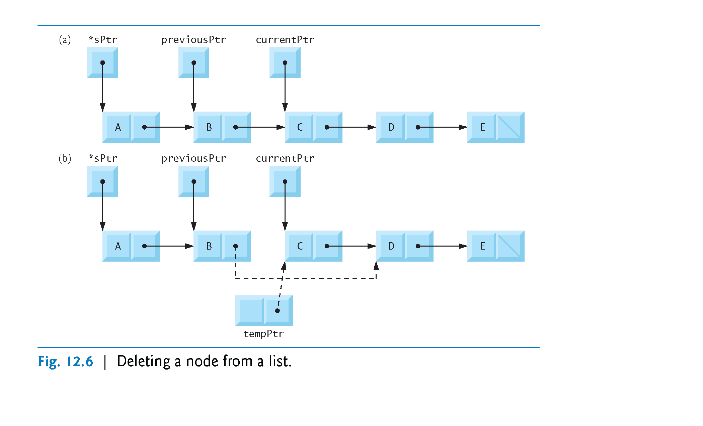

Slide 15
An example to illustrate
Assume size of node = 4
Assume address of head/startPtr node is 0x00
Assume address of sPtr is 0x02
Assume address of current is 0x04
Assume address of previous is 0x06
Address of the first new node is 0x12
Address of the another new node is 0x16…..
Assuming sPtr is a double pointer and points to startPtr. What is the value of *sPtr?
What would be the address and contents of the nodes and the pointers in the previous example ?

Slide 16
case 2: // delete an element
// if list is not empty
if (startPtr != NULL)) {
printf("%s", "Enter character to be deleted: ");
scanf("\n%c", &item);
// if character is found, remove it
if (delete(&startPtr, item)) { // remove item
printf("%c deleted.\n", item);
printList(startPtr);
}
else {
printf("%c not found.\n\n", item);
}
}
else {puts("List is empty.\n");}
break;
default:
puts("Invalid choice.\n");
menu(); // a simple function to print a menu
break;
} // end switch
printf("%s", “enter choice: ");
scanf("%u", &choice);
}
puts("End of run.");
}

Slide 17
// delete a list element
char delete(ListNode * *sPtr, char value)
{
// delete first node if a match is found
if (value == (*sPtr)->data) {
ListNode* tempPtr = *sPtr; // hold onto node being removed (for safety)
*sPtr = (*sPtr)->nextPtr; // start points to 2nd node
free(tempPtr); // free the (first node pointer)
return value;
}
else {
ListNode* previousPtr = *sPtr;
ListNode* currentPtr = (*sPtr)->nextPtr;
// loop to find the correct location in the list
while (currentPtr != NULL && currentPtr->data != value) {
previousPtr = currentPtr; // walk to ...
currentPtr = currentPtr->nextPtr; // ... next node
}

Slide 18
//
if (currentPtr != NULL) {
ListNode* tempPtr = currentPtr; (safety)
previousPtr->nextPtr = currentPtr->nextPtr;
free(tempPtr);
return value;
}
}
return '\0'; // return null if value is not found
}

Slide 19
Printing all the elements
// print the list
void printList(ListNode* currentPtr)
{
// if list is empty
if (currentPtr == NULL) {
puts("List is empty.\n");
}
else {
puts("The list is:");
// while not the end of the list
while (currentPtr != NULL) {
printf("%c --> ", currentPtr->data);
currentPtr = currentPtr->nextPtr;
}
puts("NULL\n");
}
}

Slide 20
Main function
int main(void)
{
ListNode* startPtr = NULL; // initially there are no nodes
char item; // char entered by user
instructions(); // display the menu
printf("%s", "? ");
unsigned int choice; // user's choice
scanf("%u", &choice);
// loop while user does not choose 3
while (choice != 3) {
switch (choice) {
case 1:
printf("%s", "Enter a character: ");
scanf("\n%c", &item);
insert(&startPtr, item); // insert item in list
printList(startPtr);
break;

Slide 21
case 2: // delete an element
// if list is not empty
if (startPtr != NULL)) {
printf("%s", "Enter character to be deleted: ");
scanf("\n%c", &item);
// if character is found, remove it
if (delete(&startPtr, item)) { // remove item
printf("%c deleted.\n", item);
printList(startPtr);
}
else {
printf("%c not found.\n\n", item);
}
}
else {puts("List is empty.\n");}
break;
default:
puts("Invalid choice.\n");
menu(); // a simple function to print a menu
break;
} // end switch
printf("%s", “enter choice: ");
scanf("%u", &choice);
}
puts("End of run.");
}

Slide 22
Sample Exam Question
Why is a link list a more efficient way of utilisation of memory than arrays (3 marks)
Explain, using a simple example, how the add/delete functions use pointers to keep tract of any changes made to the pointer to the beginning of the list (5 marks)

Slide 23
Sample Question
Clearly explain, using diagrams include sample memory addresses , how you would:
add a node to a link list, at the start at the middle and at the end
Delete a node from, the start, middle and end of a link list (15 marks)

Slide 24
Explain what the following code does paying particular attention to pointers and pointer dereferencing
void printList(ListNode* currentPtr)
{
// if list is empty
if (currentPtr == NULL) {
puts("List is empty.\n");
}
else {
puts("The list is ");
// while not the end of the list
while (currentPtr != NULL) {
printf("%c --> ", currentPtr->data);
currentPtr = currentPtr->nextPtr;
}
puts("NULL\n");
}
} (10 marks)

Slide 25
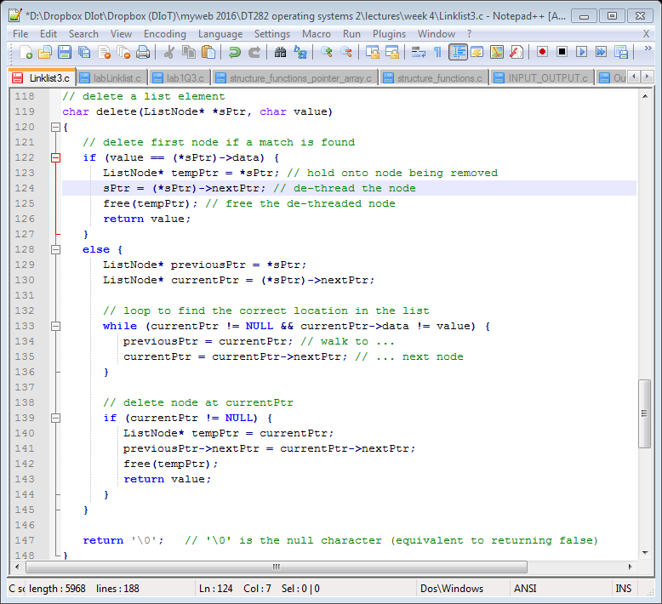
Clearly explain if the following code will delete a node from a link list

